Slide 1
AWS Glue
By: Steven Will

Slide 2
Fully Managed ETL Service

Slide 3
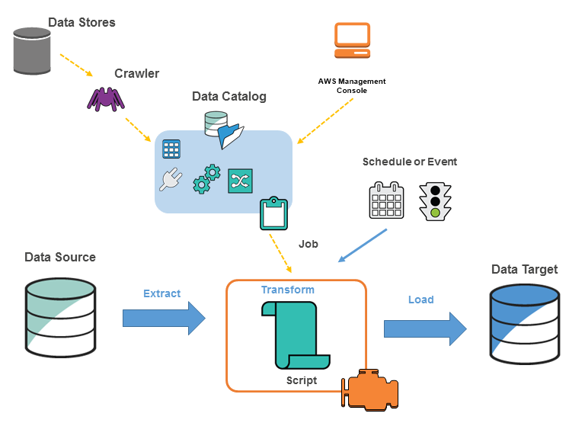
Components:

Slide 4
Usage:
Serverless queries against S3 data lake
Build a warehouse
Event driven ETL pipelines
Simply understand data

Slide 5

Benefits:
Cost effective
Less hassle then traditional, on-prem setups
Unlimited power!

Slide 6
Dynamic Frames
Similar to a pandas or spark dataframe
Instead of conforming to a schema, each record is self-describing
If there are records that don’t fit a schema, no problem
Will often be converted back into a standard dataframe after the transformation step

Slide 7
Walkthrough / Demo
Create S3 folder to read and write data
Data is added to S3 (e.g. data lake)
Create a crawler to scan S3 folders
Run the crawler
Locate the table
Create a job
Modify the script if desired (we will be)
Run job

